Slide 1


HCT Survival Equity System
From Analysis to Design
Universidad Distrital Francisco José de Caldas – 2025
Sergio Nicolás Mendivelso Martínez • Sergio Leonardo Moreno Granado • Juan Manuel Otálora Hernández • Juan Diego Moreno Ramos
Professor: Ing. Carlos Andrés Sierra, M.Sc.

Slide 2


General Objective
Build a Predictive System
Ensure Fairness
Guarantee precision and equity across diverse demographic groups in predictive models.
Develop an advanced survival prediction model specifically for post-HCT outcomes.
Apply Engineering Principles
Integrate systems engineering and fair machine learning methodologies.

Slide 3


System Analysis
Exploration & Identification
Variable Assessment
Deep examination of the medical context surrounding hematopoietic cell transplantation, including clinical protocols, treatment variations, and patient outcomes across different healthcare settings.
Comprehensive identification and evaluation of clinical, genetic, and demographic variables that influence survival trajectories post-transplant.
Sensitivity Analysis
Evaluate system responsiveness to variable changes.
Chaos in Clinical Outcomes
Investigate nonlinear dynamics affecting results.
Stratified C-Index Measurement
Apply fairness metrics across demographic groups.

Slide 4

Key Analysis Findings
High Complexity
Medical systems exhibit strong nonlinearity and interdependencies that traditional linear models cannot capture effectively.
Critical Variables Identified
Patient age, HLA compatibility, and comorbidities emerge as primary drivers of post-HCT survival outcomes.
Chaotic Effects
Small variations in initial conditions produce dramatically different clinical trajectories, requiring robust modeling approaches.
Model Requirements
Systems must be robust, interpretable, and fair—balancing accuracy with explainability and equity across populations.

Slide 5

System Design Architecture
The proposed HCT Survival Equity System implements a modular, scalable architecture designed to handle medical complexity while maintaining fairness and transparency.
Data Pipeline
Evaluation Framework
Patient intake and clinical data ingestion
Fairness calibration modules
Uncertainty quantification
Preprocessing and quality validation
Performance monitoring
Feature extraction and transformation

Slide 6
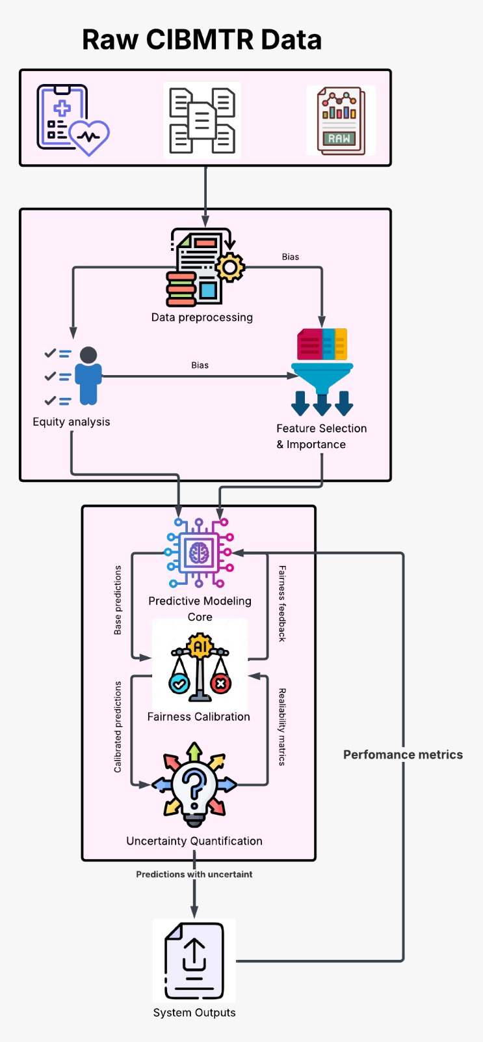
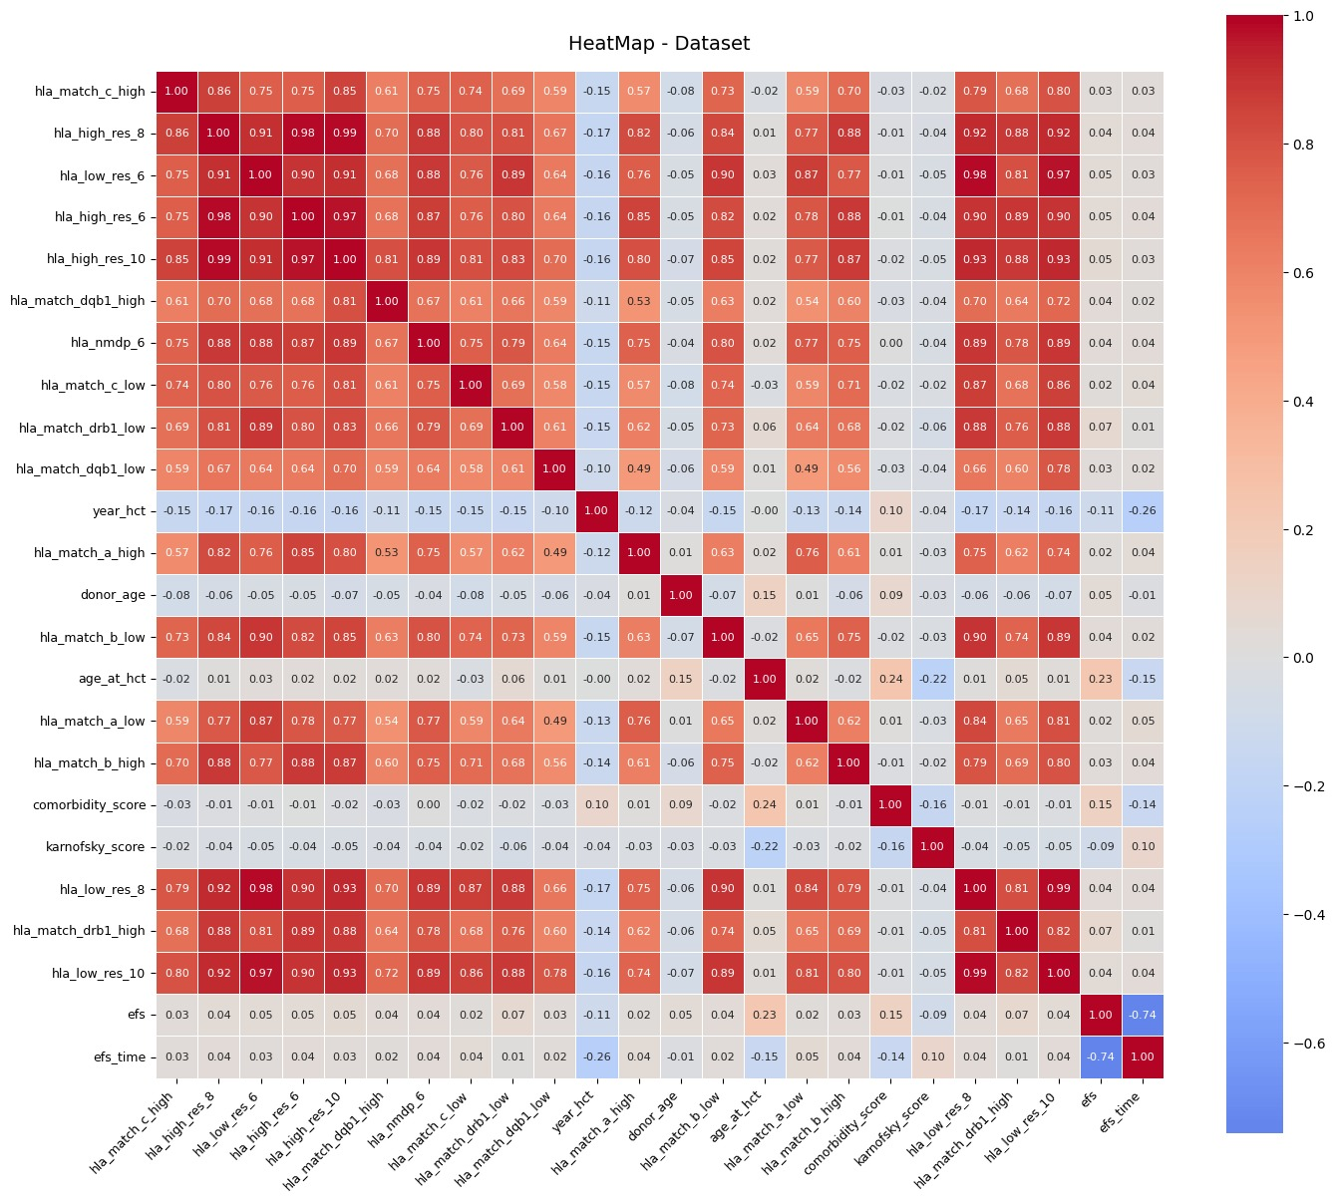
System
Diagram
Heat Map

Slide 7
Core System Modules
1
Data Preprocessing
Standardization, cleaning, and validation of clinical datasets.
2
Equity Analysis
Detection and quantification of demographic disparities.
3
Feature Selection
Identification of clinically relevant predictive variables.
4
Predictive Core
Machine learning models for survival outcome forecasting.
5
Fairness Calibration
Adjustment mechanisms to ensure equitable predictions.
6
Uncertainty Quantification
Confidence intervals and prediction reliability metrics.
7
Output & Metrics
Results reporting and clinical decision support.

Slide 8









Design Principles Applied
Modularity
Decoupled components enable independent updates and scalability across different healthcare systems.
Robustness
Designed to handle chaotic medical data while maintaining performance stability under real-world conditions.
Reproducibility
MLflow and Docker containerization ensure complete traceability and reproducible results across environments.
Balanced Trade-offs
Intentional optimization across precision, interpretability, and fairness metrics.

Slide 9

Expected Results
Demographic Stability
Models demonstrate consistent performance across all demographic groups without significant disparity.
Improved Stratification
Enhanced stratified C-Index metrics enable better patient risk segmentation and personalized treatment planning.
Clinical Confidence
Explainability features and fairness metrics increase clinician trust and adoption in real hospital settings.

Slide 10

Conclusion
This system represents a comprehensive engineering approach to resolving the fundamental tension between predictive accuracy and algorithmic fairness in clinical applications. By integrating rigorous technical analysis, medical sensitivity, and ethical principles, we advance the field toward more transparent and equitable clinical artificial intelligence.
Technical Excellence
Ethical Foundation
Sophisticated modeling addresses medical complexity and nonlinearity effectively.
Fairness-first design ensures equitable outcomes across diverse patient populations.
Clinical Impact
Stepping stone toward transparent, accountable, and equitable clinical decision support systems.

